Slide 1
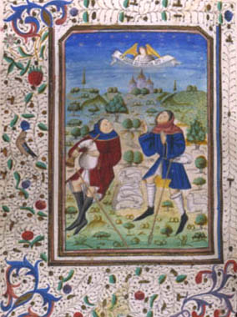
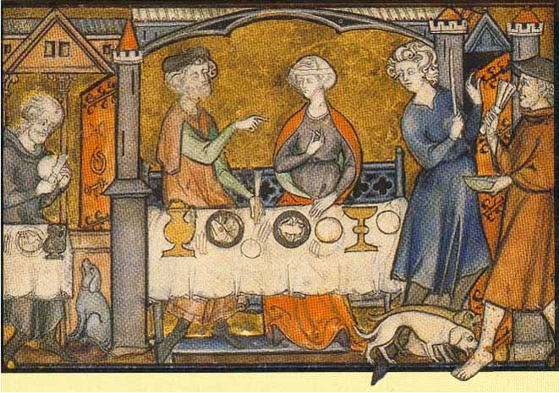
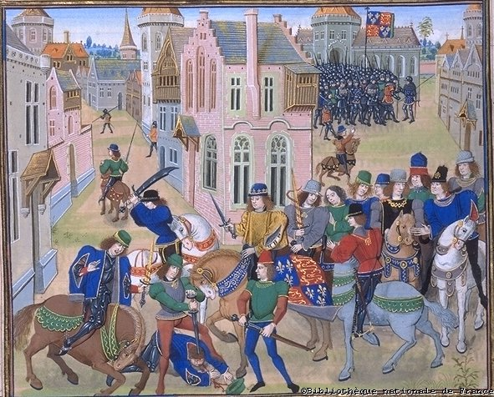
High Middle Ages PPT #2

Slide 2
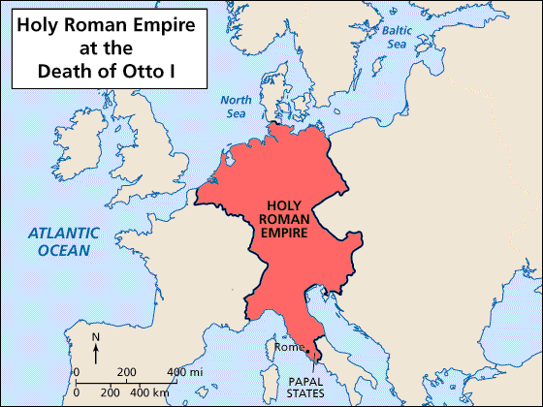
The Germanic people did not develop a strong central government. The Germanic peoples and Italian City-States became bitter rivals.
In 936, Otto the Great was elected king by the Germanic feudal lords. He defended Pope John XII (12th) against unruly Roman nobles and the Pope crowned him “Emperor of the Romans.”
Otto’s Holy Roman Empire was much smaller than Charlemagne’s – but it continued for more than 800 years

Slide 3
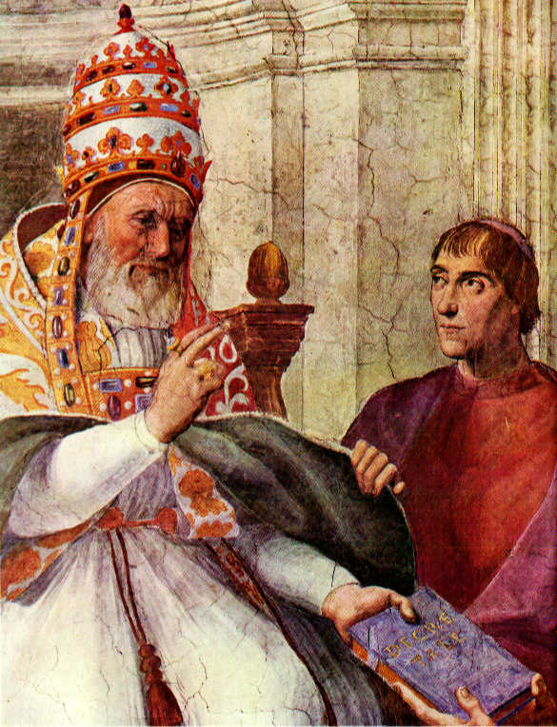
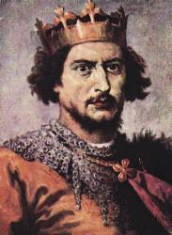
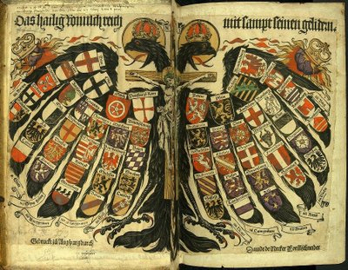
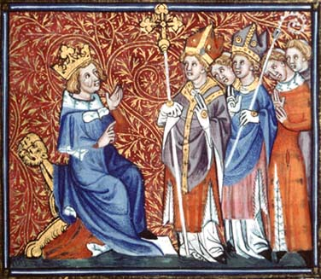
A struggle developed between the Holy Roman Empire (the Germanic Kings) and the Church (the Popes).
The kings said they could appoint Bishops, and the Pope said only he could do that.
Pope Gregory excommunicated King Henry IV (4th) because of this.

Slide 4
Wanted to reform corrupt church leaders who plotted with the king to increase their power and wealth
In 1075 outlawed church officials chosen by king
Angered by Pope Gregory’s actions because he needed church leaders to support him against powerful Germanic Lords
Gregory the 7th)
Henry the 4th
Threatened to excommunicate any king who disobeyed (thus taking away their salvation)
Henry IV (4th) demanded that Gregory VII (7th) resign as Pope
Henry IV (4th) was excommunicated by Pope Gregory VII (Gregory 7th)
Henry realizes he cannot defeat Pope and begs for forgiveness – Henry is forgiven - feud continues, excommunicated again-marches on Rome
1122 Emperor Henry V (the 5th) reaches a compromise in the Concordant of Worms- church to appoint bishops – Kings to give titles and land

Slide 5
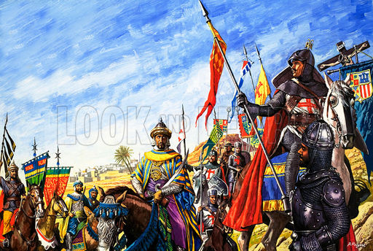
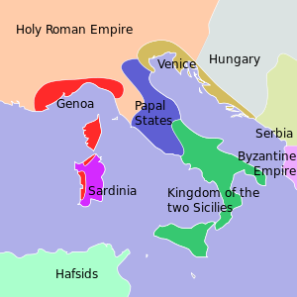
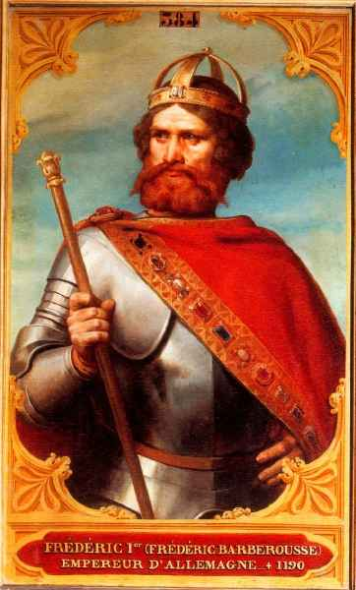
1100s & 1200s – German Emperors (Holy Roman Empire) sought to control Italy
Caused problems with the Pope and wealthy cities in N. Italy.
Frederick I and Frederick II of Germany both fought for control of wealthy Italian cities

Slide 6
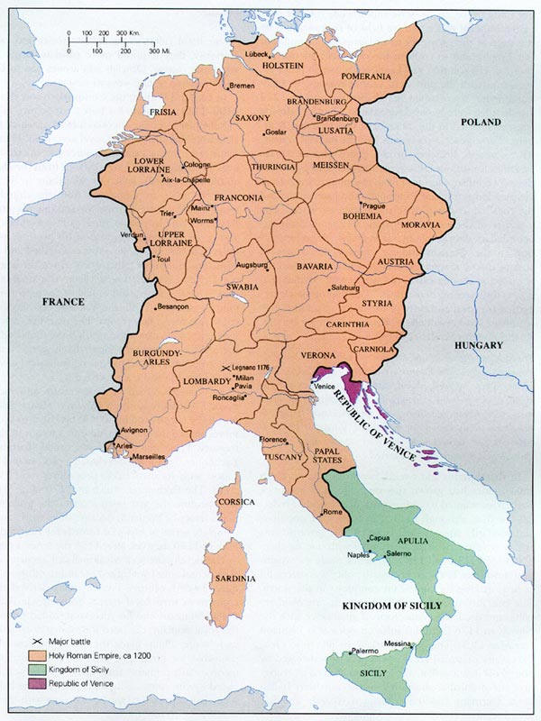
German nobles grew in power
Holy Roman Empire = patchwork of feudal states
Germany would not become a nation state for 600 years
France and Spain also fought over power in Italian city states

Slide 7
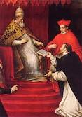
1200s – Church reaches the peak of its political power
Some popes claimed the right to depose kings
1198 – Pope Innocent II claimed supremacy over all other rulers – he was one of the most powerful popes in history
He also strengthened Papal power and revised rules within the church
After 1296 when there were two popes, one in France and one in Rome (remember Philip IV (the 4th) of France, 1305) – the power of the popes declined.

